Slide 1






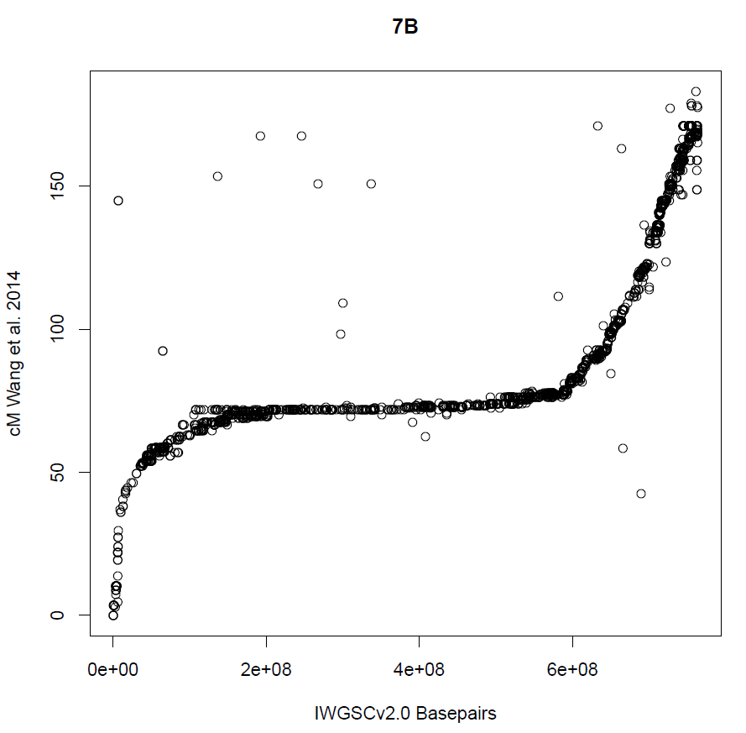
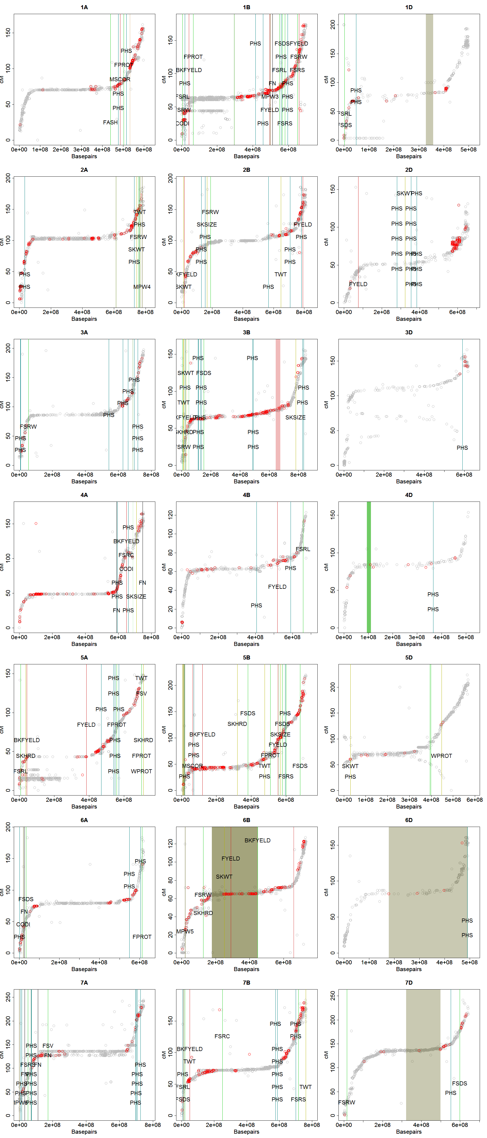
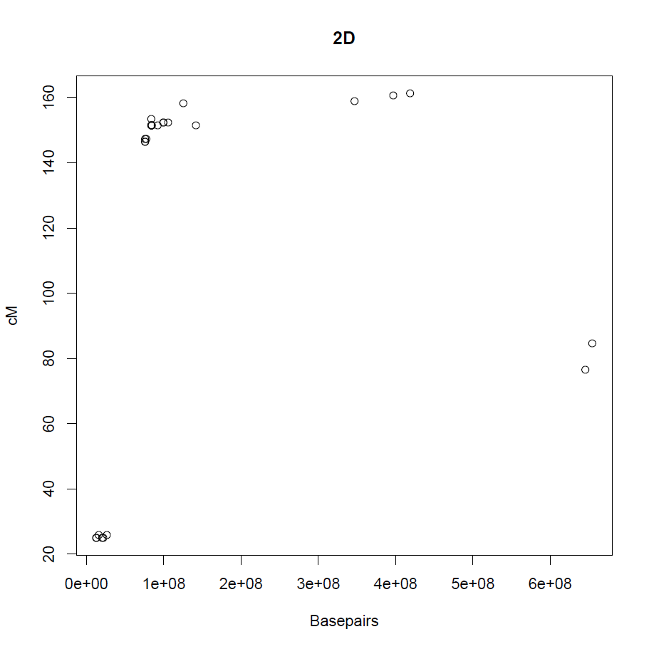
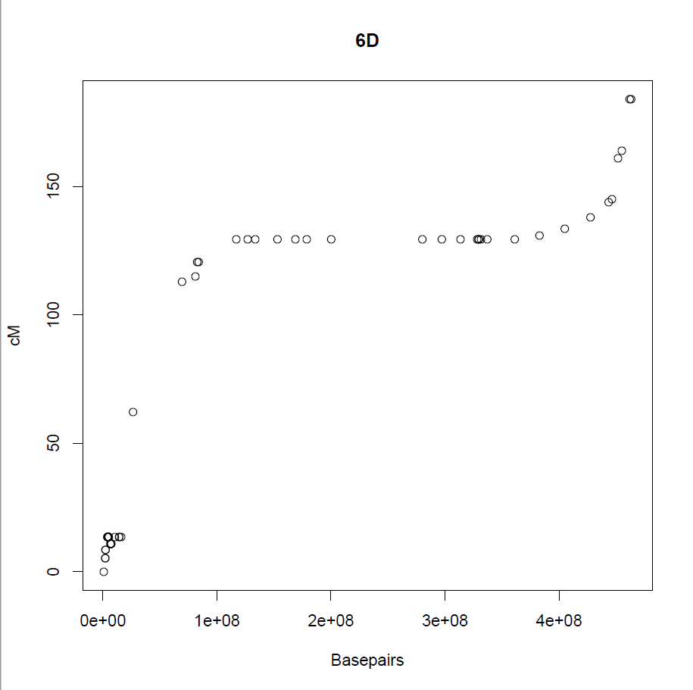

Using MAST to Apply Wheat Quality QTL
Knowledge in Other Populations
Scott Carle, Kimberly Garland-Campbell.
The Problem
Most economically important traits in plants are genetically controlled by many loci. Theoretically, there must be some optimal combination of loci for desired performance in a specific growing environment. The goal of crop breeding is to select for a higher concentrations of these locally optimal alleles than what is currently available to growers and end-users.
For several years crop geneticists have been conducting mapping studies to identify the number and location of important loci that control key economic traits. However, the bulk of this wealth of knowledge is difficult to apply. Among the difficulties are:
Different markers and marker platforms were used between studies.
Polymorphic markers correlating with a trait in a particular study may not correlate with that trait in other populations.
Centimorgan (cM) maps, which are commonly used to define locations of loci, have varying degrees of accuracy and cross-comparability.
QTL studies and are known to produce false positives.
The variety of reporting methods requires a systematic and adaptable cataloguing system.
Here we demonstrate that the MAST script suite for R is a useful tool to resolve these difficulties and enable users to more easily compile and cross-compare the findings from multiple studies.
What is MAST?
Wheat Quality Loci
Interpreting the Plots
The MAST [Markers Around Segregating Traits] Script Suite is a series of scripts for use in the programming language R, that compile large amounts of marker data and partition them into chromosome graphs according to linkage position and physical position, with varying degrees of labeling.
The backbones of the datasets for MAST are double-anchored consensus maps, with both physical and linkage positions for sets of trusted markers.
Fig 3: Physical positional data was drawn from the IWGSC v2.0 wheat genome₅ and consensus map linkage data was drawn from Wang et al. 2014₄. The data for linked loci and flanking markers for wheat QTL associated with quality traits [here represented as vertical lines and shaded regions of uncertainty] were taken from 3 publications: Naraghi et al. 2019₁, Martinez et al. 2018₂ and Jernigan et al. 2018₃.
These trait-associated markers were cross referenced with markers that were mapped in both base-pairs and centimorgans. A small fraction of observations were not successfully placed on the physical map and were omitted.
Fig. 3: Additional scripts in the MAST suite allow incorporation of further data into the plots. The common markers in the consensus and physical maps are delineated in gray. Polymorphic markers between two cultivars of interest (in this case Finch and Eltan) are overlaid and plotted in red. Loci of interest were plotted by color according to the key.
To deal with varying reporting methods, two loci plotting methods were used. Where flanking markers were reported to be bracketing the loci affecting a specific trait, a transparent rectangle was drawn to represent the region between the flanking markers. Where specific markers was reported to be associated with a trait, the precise locations of those markers were plotted as vertical lines. Labeling can include specific marker names, or trait names, but can also display the marker calls for up to 2 individuals at a time.
These scripts can quickly display where nearby polymorphic markers are to a locus of interest, and output a spreadsheet including the detailed data. They allow for approximate linkage comparisons in markers that have not previously been mapped by linkage. They allow for rapid compilation and comparison of many times of marker and locus data.
Figure 1
Figure 3
A
Chromosome Plots:
B
D
1
2
3
4
5
6
7
Honing Resources
3X7
plot
MAST also assists with improving the reliability of our mapping and marker resources. The isolated markers in Figure 1 that do not lie on the main trend line indicate that at least one of the resources is in error about the position of each of those markers. Treating such markers with caution is prudent.
A MAST scripts enables interaction with plots, Markers of interest can be selected and a list with marker details is generated. This is quite useful for assembling marker scaffolds, lists of markers that deserve additional scrutiny, or to select specific linked markers around a locus of interest.
The Chromosome Plot
Fig 1: MAST generates a plot for every chromosome. Along the X-axis are the base-pairs of the physical map. Along the Y-axis are the centimorgans of the linkage map. Most markers on a robust plot fall into the sigmoid curve configuration. The steep sections are the recombination rich regions along the chromosome arms. The flat section in the region of suppressed recombination around the chromosome centromere.
To Start
Map Integrity
Requirements:
1) Data: A linkage map and a physical map for a set of markers.
2) Software: R or R-Studio, MS Excel or other spreadsheet software
Optional Enhancements:
QTL data, marker data for genotypes of interest, markers of interest, BLAST positions for genes of interest
Fig. 2: The MAST scripts can assess map integrity. To this end, MAST offers users an easy alternative to tangled 1-dimensional linkage comparisons.
By plotting out the markers by chromosome, one can follow the progression of linkage distances against the physical map. In Figure 2a, the chromosome plot portrays a highly improbable marker order, and likely artificially inflating linkage distance elsewhere. Figure 2b matches expectations and is a more reliable map.
Cross-Compatibility of Marker Platforms
Comparing data from different genotyping platforms (SNP-chips, GBS data, KASP markers, etc.) can be quite difficult, particularly when comparing linkage maps, but for MAST, if you can BLAST it, you can use it.
The MAST script suite is fully compatible with all bi-allelic marker data and has some functionality for multi-allelic marker data.
Figure 2
a
b
Key:
Scripts, User Manual & Data Availability
Concerning
Consistent
https://github.com/ScottCarleTheBiologist/MAST-Script-Suite
Acknowledgements
Citations
USDA-NIFA-ELI Project# WNP06340
USDA-inhouse Project# 2090-21000-033-00D
Washington Grains Commission project: 3019-3156
1) Naraghi, Sepehr Mohajeri, et al. "Deciphering the Genetics of Major End-Use Quality Traits in Wheat." G3: Genes, Genomes, Genetics 9.5 (2019): 1405-1427.
2) Martinez, Shantel A., et al. "Genome-Wide association mapping for tolerance to Preharvest Sprouting and low Falling Numbers in wheat." Frontiers in plant science 9 (2018): 141.
3) Jernigan, Kendra L., et al. "Genetic dissection of end-use quality traits in adapted soft white winter wheat." Frontiers in plant science 9 (2018): 271.
4) Wang, Shichen, et al. "Characterization of polyploid wheat genomic diversity using a high‐density 90 000 single nucleotide polymorphism array." Plant biotechnology journal 12.6 (2014): 787-796.
5) A chromosome-based draft sequence of the hexaploid bread wheat (Triticum aestivum) genome, Science, 2014:345 (DOI: 10.1126/science.1251788)
In progress: MAST: an R Script Suite for analyzing and visualizing multiple types of genetic marker data
In progress: Untangling the Maps: a Cross-examination of Wheat Marker Database Resources

